Slide 1
Historical Growth Analysis
of the EV Market In The USA
Team 5

Slide 2







Team Members
Project Manager
Michael Webber
Data analyst
Shiv Nag
Data analyst
Yashna Meher
Data analyst
Adriano Nogueira
Data analyst
Ming Hua Tsai
Data analyst
Jun han Chen

Slide 3
AGENDA
Motivation, Business Goals, & Resources
Analysis of U.S. EV Infrastructure
State-by-State EV Trend Comparison & Vehicle Insights
Challenges and Conclusion

Slide 4
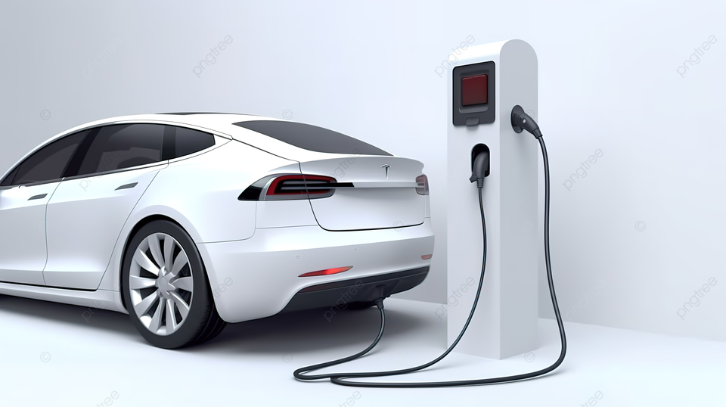
Motivation
2023 global EV registrations reached 14 million
Does the U.S. market still have untapped potential?
We aim to assess the U.S. EV market potential from a macroeconomic level
Our analysis:
U.S. EV growth (2018-2023)
Focus:
vehicle registration and charging station infrastructure
Goal:
Uncover trends and insights into the factors driving EV adoption.
Reference: https://www.iea.org/reports/global-ev-outlook-2024/trends-in-electric-cars
Notes:
Our analysis is built on a shifting flow from breadth to depth. We were initially interested in observing EV growth in the U.S. from 2018 to 2023 to see how the landscape of this market changed from pre-COVID to post-COVID. Our next step was to analyze the key outliers in the EV market, which fell in the category of states. Finally, we were interested in how the U.S. responded to growth or decline in EV's, in the form of scaling its infrastructure by providing an appropriate amount of charging stations (aka, did supply meet demand at scale?). This required us to create a join of our two datasets and create a relational database, to compare Electric Vehicles to EV Stations available. To support such a large market, there must be a strong infrastructure to support its growth. Beyond this, having more EV stations available could possibly encourage drivers to switch to an EV. Here begins our analysis:

Slide 5
Business
Goal
Predict Market Growth and Competitiveness
Use insights to forecast EV adoption trends and recommend improvements to enhance competitiveness.
Analyze the market conditions of different states
15 %
Analyze the growth of EV stations and EV vehicle registrations in key states, as well as popular makes & models
45 %
Identify Key Drivers of EV Adoption
65 %
Analyze factors influencing the rise of electric vehicle registrations in the U.S., focusing on charging station expansion.

Slide 6
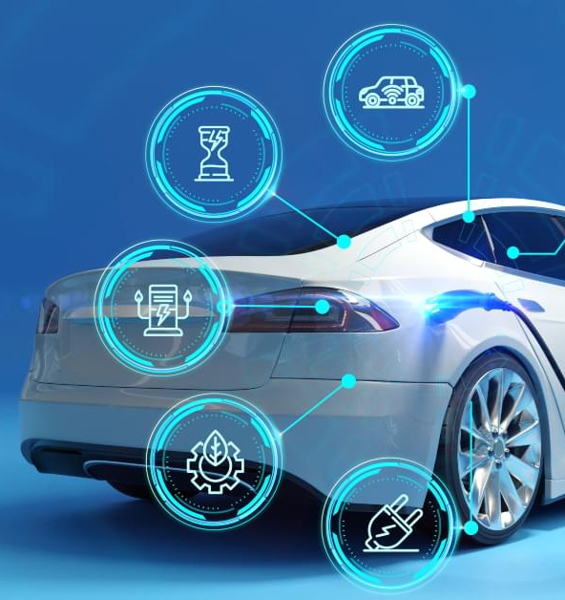
Data Resources
U.S. Department of Energy’s database of alternative fueling stations in the U.S., starting in 2024:
https://afdc.energy.gov/stations/states
State EV Registration Database
https://www.atlasevhub.com/materials/state-ev-registration-data/#data
Notes:
Adriano

Slide 7
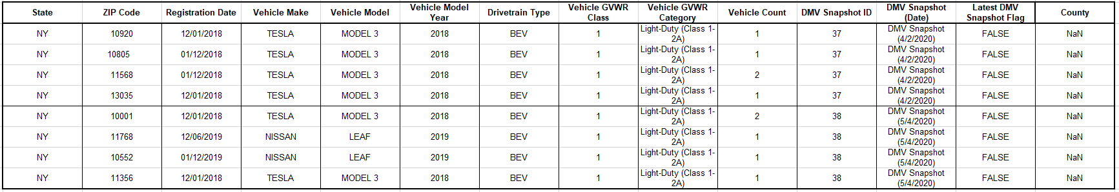
Data Resources
State EV Registration Database :
DMV Snapshot (Date)
Notes:
Adriano

Slide 8
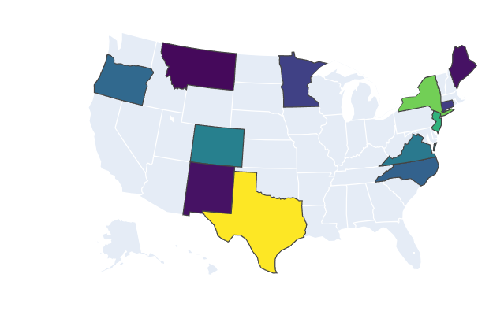
Data Resources
State EV Registration Database :
DMV Snapshot (Date)
States selection
12 states with available data
Some states had unusable formats
Notes:
Colorado, Connecticut, Maine, Minnesota, Montana, New Jersey, New Mexico, New York, North Carolina, Oregon, Texas, and Virginia.
Some states (like California) had a different table format, which made impossible to use with the other states.
Adriano

Slide 9
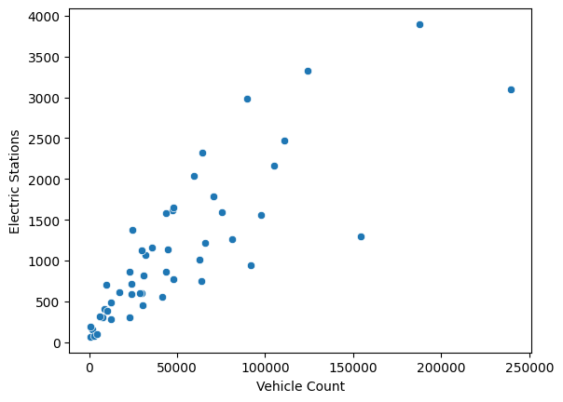
Data Resources
State EV Registration Database:
DMV Snapshot (Date)
States selection
Linear Regression Imputation
Notes:
Linear regression model, using “Electric Stations'”and “Electric Charging Points” features, to interpolate the missing data for the number of EV registrations for each state in each year.
Adriano

Slide 10
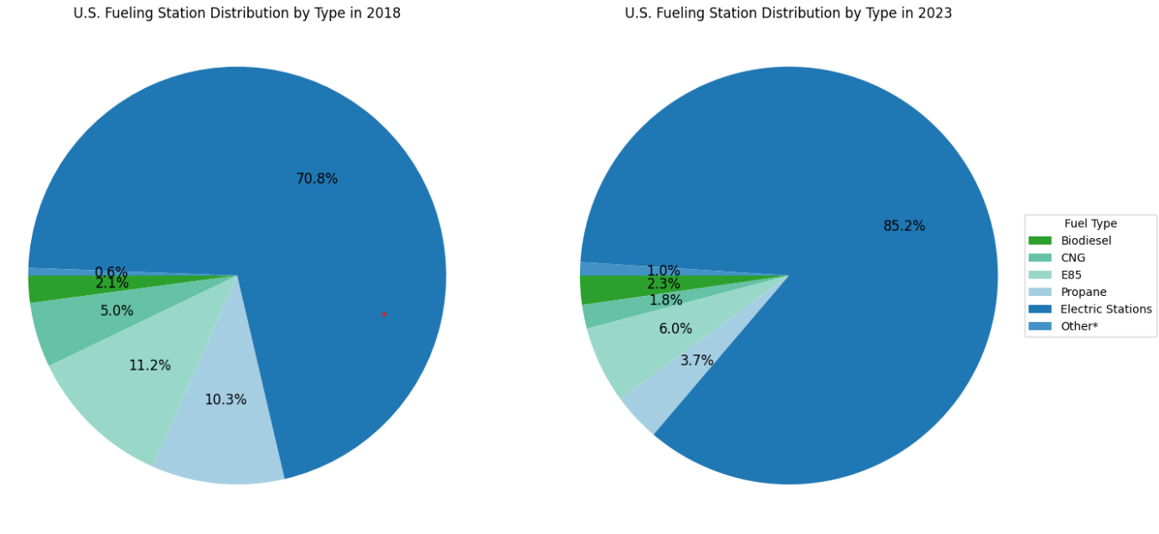
Q1: What is the distribution of various fueling stations throughout the U.S.? How is 2018 different from 2023?
01
Pre-COVID Outlook
EV Stations - 71%!!! E85 - 11% Propane - 10%
02
Post-COVID Outlook
EV Stations - 85%!!! E85 - 6% Propane - 4%
Notes:
*Other - LNG (0.39%), Hydrogen (0.19%), Renewable Diesel (0.02%) for 2018
*Other - LNG (0.12%), Hydrogen (0.10%), Renewable Diesel (0.80%) for 2023
Fueling Station Distribution by Type of Fuel in 2018 v.s. 2023 (pre vs post COVID)
Critical Observations: Electric Stations (which serve EVs) dominate the alternative fueling station market in the U.S., with over nearly 70& (2018) to 85% (2023) of the alternative fuel stations available being electric. The closest alternative fuel behind electric is E85, which is a mix of ethanol and gasoline, which has approximately 11% (2018) to 6% (2023) of the market share. Surprisingly, EV stations have seen an increase in their share by 15% from 2018 to 2023. Part of this could be explained by the increasing availability and popularity of EVs. As the EV station count has significantly increased over the observed time period, other alternative fuel source are seeing stagnation or contraction.

Slide 11
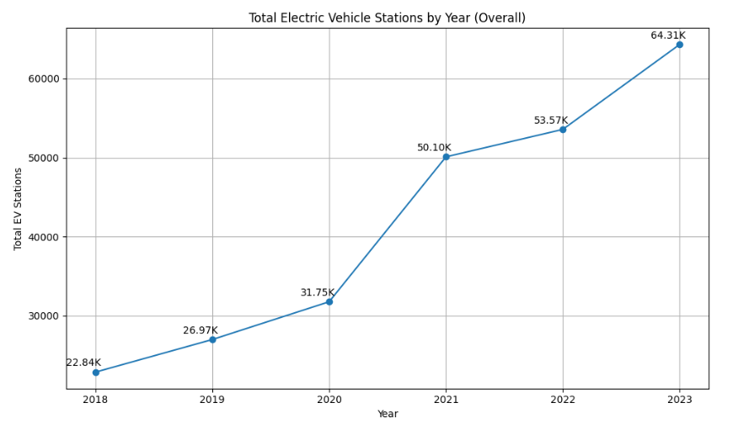
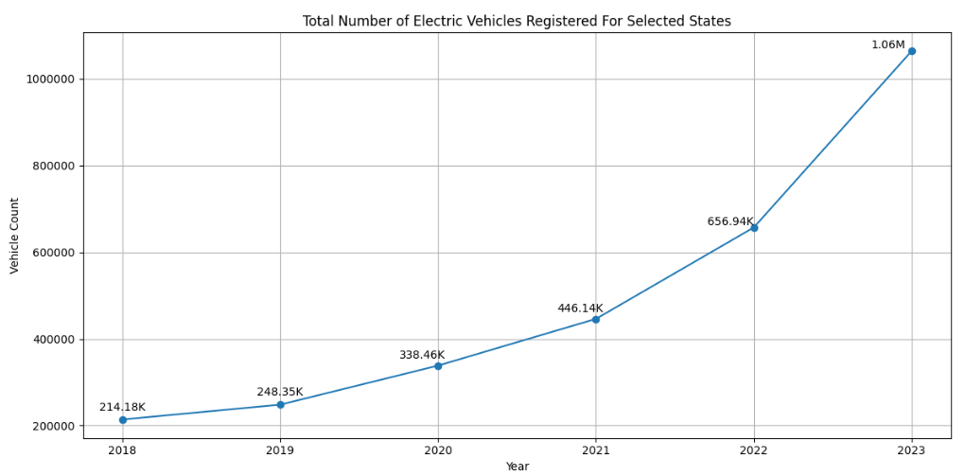
Q2:What has the growth of EV Stations and Registrations looked like in the US?
~5x More
~68% Growth
*Only looking at our 12 states for analysis
Insights
Significant growth in both the EV Stations and EV Registrations over this 5 year window
It will be interesting to see which individual states are leading the charge in both categories
Notes:
When looking at the EV station growth, we are looking at the growth throughout the entire country. Year over year, the number of charging stations is growing by about ~20%. However, from 2020-2021, we see an increase by 68%, much larger than any other year. This can be attributed to some laws passed by State governments during this period
As we can see over time, the number of EV registration takes off. These numbers only contain the values from the 12 states that we are investigating, but we believe we can expand these findings to the rest of the United States. Progress is slower from 2018-2020, but the following years there is a large uptick in the number of EV registrations. This is great to compare against the number of charging stations and the growth of the infrastructure. While the stations see consistent growth, the scale at which they are growing appears much smaller than the growth of EV registrations.
We will have to dig deeper into a state level analysis to determine if different states are better suited for this recent growth in EV registrations.

Slide 12
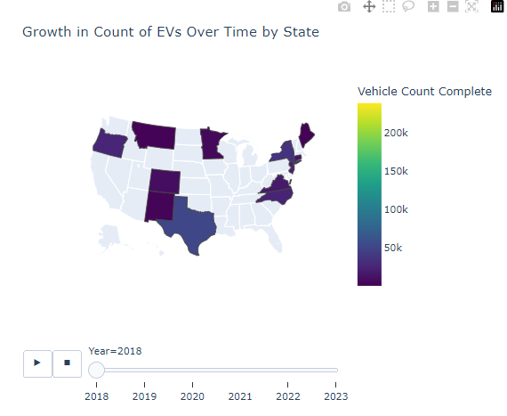
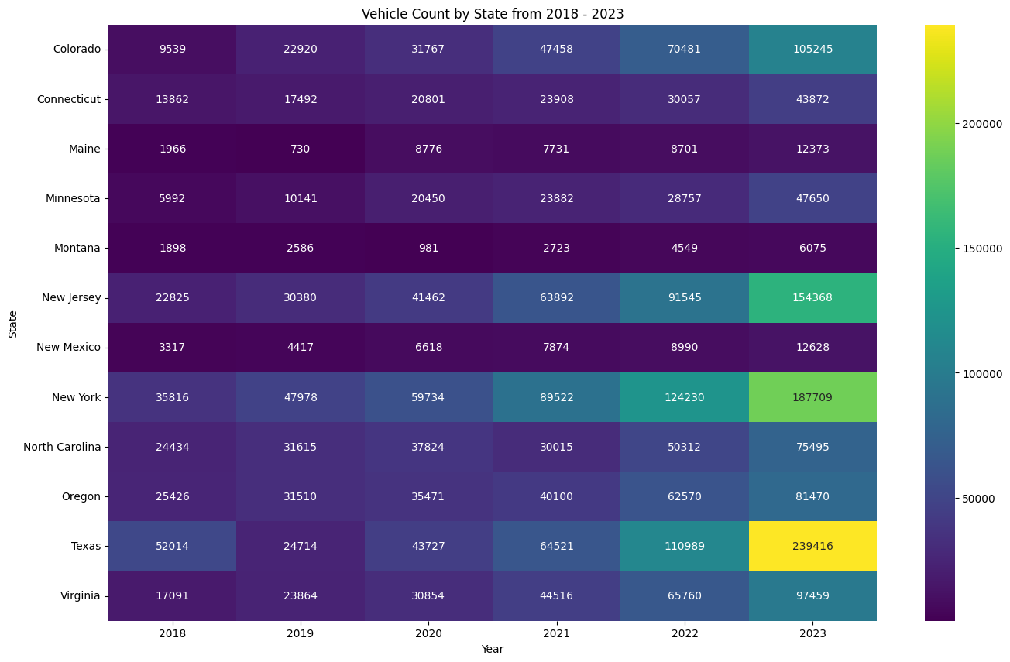
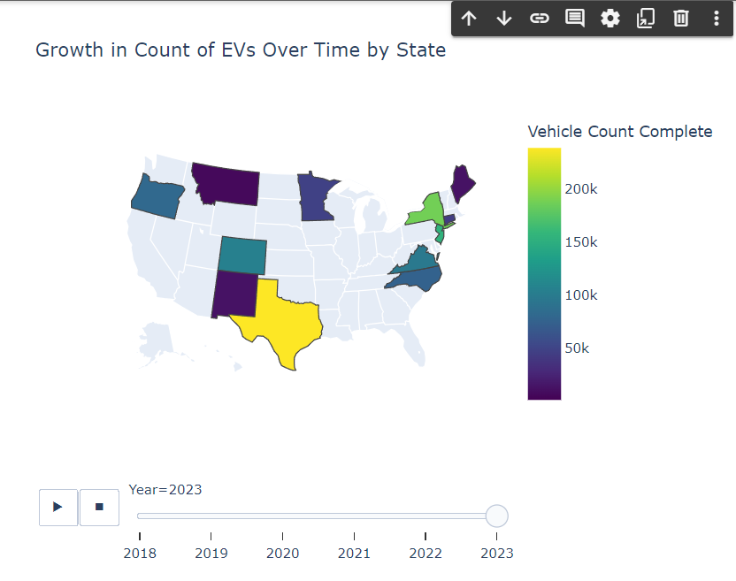
Q3: How can we more clearly see the growth of each state over time?
01
Varied Growth Rates
Range from slow to exponential growth
Notes:
Use a heatmap of Vehicle count by state over the observed period. Keep note of the linear regression that was used to backfill states (Which states was it so we are clear)
Explanation of how we arrived at this final heat map:
Heatmap showing information about registered cars for each state in each year. Car registration data varies from state to state, with different frequencies and completeness. We noticed that some states do not have snapshot data for specific years. Therefore, to generate more interesting visualizations, three approaches were considered.
One method would be to use interpolation, where new data can be added between periods of missing data, using linear regression that takes into account the values ​​of previous and subsequent points, avoiding gaps between two years of data.
Another approach would be to use linear regression that considers the features 'Electric Stations' and 'Electric Charging Points' to predict the 'Vehicle Count' for each year, assuming that these features have a linear relationship (the more stations, the more electric cars on the road). This way, we can see what the expected data would be for years without data. We noticed that in some states, the number of vehicles increases and then decreases when we reach the actual data (like Montana). This indicates that the state was expected to have a higher number of cars based on the number of electric stations installed.
Finally, a third option would be the default view, without any data imputation technique and therefore with some years of missing data for certain states.
In the end, the group decided to use linear regression so that all missing data would be filled in by the model prediction.

Slide 13
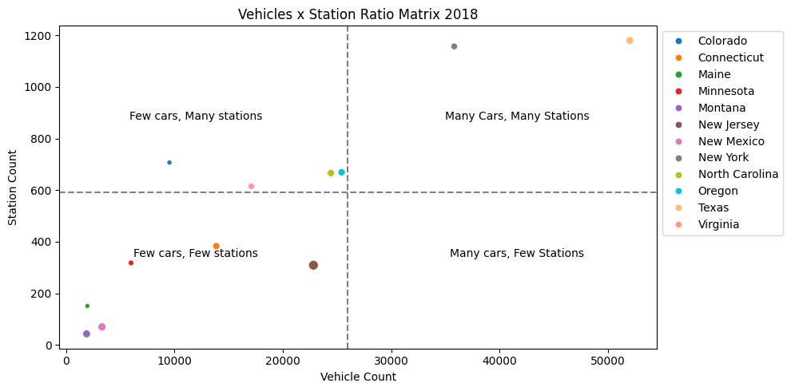
Q4: How can we categorize states according to the number of registered cars and electric stations?
01
Top Right Quadrant
01
Key area showing states with high EV growth
Insights
New York and Texas are the leading states in terms of EV Registrations and Stations

Slide 14
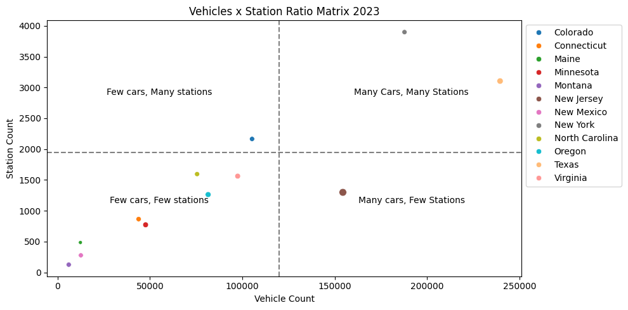
Q5:How can we categorize states according to the number of registered cars and electric stations?
01
EV/Stations Ratio
02
A higher ratio indicates higher disparity between the number of cars and the necessary infrastructure to support them
Insights
New Jersey (bottom right) needs to improve its infrastructure
Maine, Montana, and New Mexico (bottom left corner) have low ratios
Notes:
Low ratios indicate that supply and demand are nearly even, which is positive for EV infrastructure

Slide 15
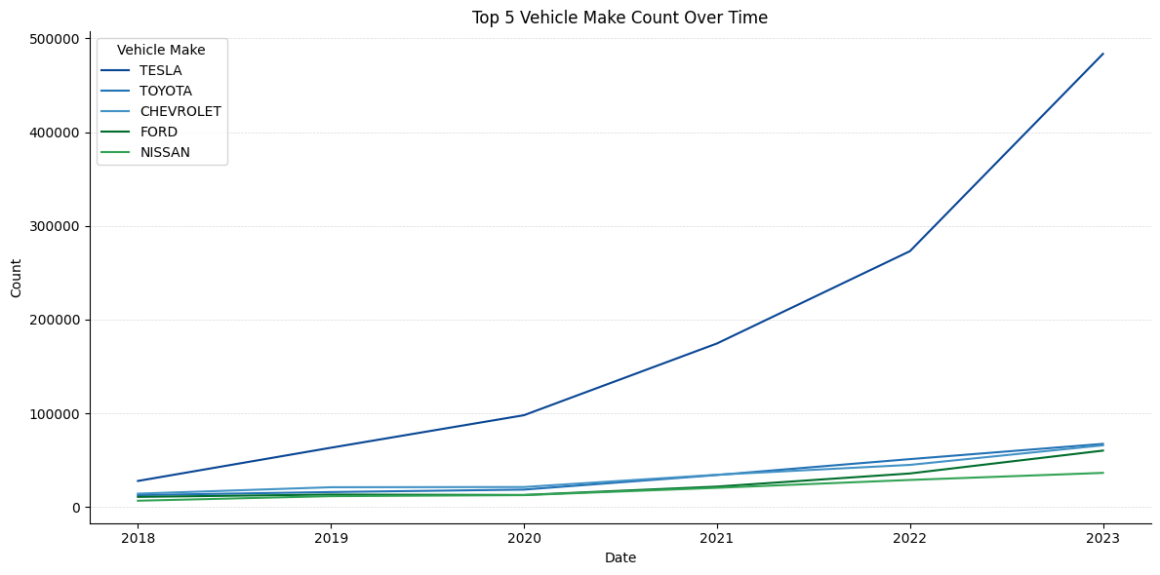
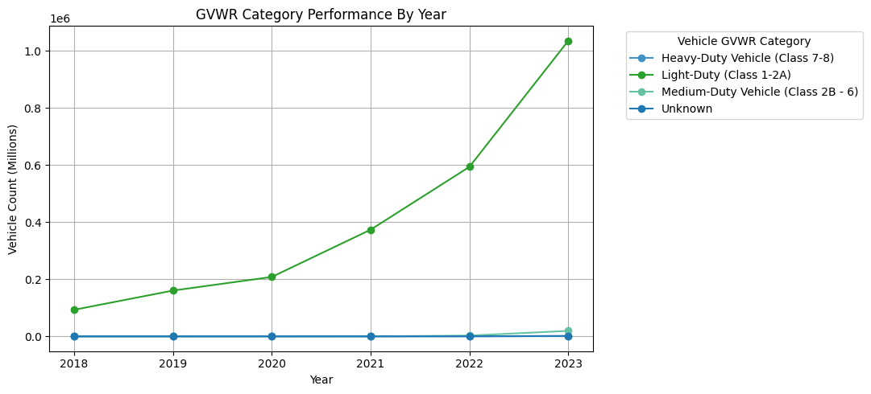
Q6:What types of EVs and brands are driving the recent growth in the electric vehicle market?
Light-Duty
TESLA
Notes:
Light_Duty EV: GVWR: Up to 6,000 pounds (Class 1) and 6,001 to 10,000 pounds (Class 2A). Passenger car and small SUV. Electric Models: Tesla Model 3, Nissan Leaf, and Chevrolet Bolt fall under this category, making it a popular segment in the EV market.
Medium: These vehicles have a GVWR ranging from about 6,001 to 26,000 pounds. Examples include delivery trucks, utility vehicles, and larger vans.
Heavy: These are the largest vehicles, such as large trucks and trailers, with a GVWR above 26,000 pounds. They are often used for long-haul transport and industrial purposes.

Slide 16
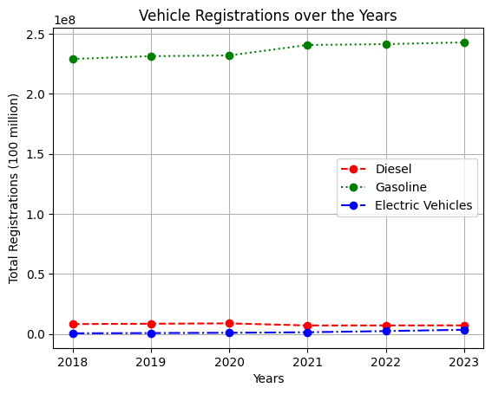
Q7:How do EV registrations compare to Gasoline and Diesel registrations?
EV adoption increasing with improvement in technology and infrastructure but there is a huge market to be captured
Notes:
The three charts compare registrations for gasoline, diesel, and electric vehicles (EVs) over the years 2018 to 2023. While gasoline and diesel registrations show some fluctuations, with gasoline slightly increasing and diesel experiencing a sharp drop in 2021, the scale of these changes is relatively minor compared to the exponential growth of EV registrations. The y-axis shows that gasoline registrations fluctuate around 230 million to 240 million, and diesel registrations decline from max of 8.8 million to 7 million. In contrast, EV registrations soar dramatically from 0.5 million in 2018 to 3.5 million in 2023, highlighting a significant shift in vehicle trends despite the more stable levels for gasoline and diesel.
This graph shows that even though more number of people are opting for EV cars than before, there is still a huge gap between the sales.
With better charging technology and infrastructure that would support EV cars, there is a huge market potential in the future.

Slide 17
CONCLUSION
Significant Increase
In both U.S. EV registrations and charging stations
Tesla
Is the most popular EV brand in the USA
Every U.S. State
Has seen a wide range of growth, with varying supply & demand
Further Research
Is advised to uncover information on specific state’s infrastructure
Notes:
Yashna

Slide 18
Questions?
Notes:
Michael

Slide 19
Thank You!

